Slide 1


Noida Institute of Engineering and Technology, Greater Noida
Input / Output Unit
Unit: 5
Computer Organization & Architecture
AMIT YADAV
Asst. Professor
ECE Department
B Tech
3rd Sem
AMIT YADAV ACSE0305 COA 5

Slide 2
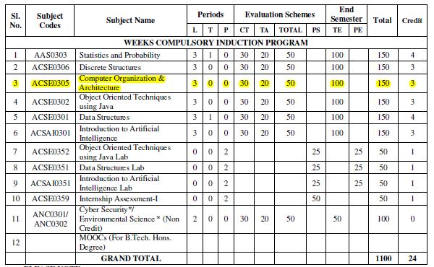
Evaluation scheme
AMIT YADAV ACSE0305 COA 5

Slide 3
Subject Syllabus
Course Contents / Syllabus
UNIT-I | Introduction | 8 Hours
Computer Organization and Architecture, Functional units of digital system and their interconnections, buses, bus architecture, types of buses and bus arbitration and it’s types. Register, bus and memory transfer. Process or organization, general registers organization, stack organization and addressing modes.
UNIT-II | ALU Unit | 8 Hours
Arithmetic and logic unit: Lookahead carries adders. Multiplication: Signed operand multiplication, Booth’s algorithm and array multiplier. Division and logic operations. Floating point arithmetic operation, Arithmetic & logic unit design. IEEE Standard for Floating Point Numbers.
UNIT-III | Control Unit | 8 hours
Control Unit: Instruction types, formats, instruction cycles and sub cycles (fetch and execute etc.), microoperations, execution of a complete instruction. Program Control, Reduced Instruction Set Computer, Complex Instruction Set Computer, Pipelining. Hardwire and microprogrammed control, Concept of horizontal and vertical microprogramming, Flynn's classification.
AMIT YADAV ACSE0305 COA 5

Slide 4
Subject Syllabus
Course Contents / Syllabus
UNIT-IV | Memory Unit | 8 hours
Memory: Basic concept and hierarchy, semiconductor RAM memories, 2D & 2 1/2D memory organization. ROM memories. Cache memories: concept and design issues & performance, address mapping and replacement Auxiliary memories: magnetic disk, magnetic tape and optical disks Virtual memory: concept implementation, Memory Latency, Memory Bandwidth, Memory Seek Time.
UNIT-V | Input/Output | 8 hours
Peripheral devices, I/O interface, I/O ports, Interrupts: interrupt hardware, types of interrupts and exceptions. Modes of Data Transfer: Programmed I/O, interrupt initiated I/O and Direct Memory Access. ,I/O channels and processors. Serial Communication: Synchronous & asynchronous communication.
AMIT YADAV ACSE0305 COA 5

Slide 5
Branch wise Applications
Computer Science:
Understanding of Computer Organization and Architecture is required for:
Performance analysis of practical software
Parallel Software and its execution
High performance databases
Modern Compilers and Code optimization
High performance game programming
Other applications
Bio-informatics, Data science using python, Web programming
For high performance computing, we require COA background.
AMIT YADAV ACSE0305 COA 5

Slide 6
Course Objective
Discuss the basic concepts and structure of computers.
Understand concepts of register transfer logic and arithmetic operations.
Explain different types of addressing modes and memory organization.
Understand the concepts of memory system and Learn the different types of memories to store data.
Explain the various types of interrupts and modes of data transfer.
AMIT YADAV ACSE0305 COA 5

Slide 7
Course Outcomes
Course outcomes : After completion of this course students will be able to
CO 1 | Understand the basic structure and operation of a digital computer system | K1, K2
CO 2 | Analyze the design of arithmetic & logic unit and understand the fixed point and floating-point arithmetic operations. | K1, K4
CO 3 | Implement control unit techniques and the concept of Pipelining | K3
CO 4 | Understand the hierarchical memory system, cache memories and virtual memory. | K2
CO 5 | Understand different ways of communicating with I/O devices and standard I/O interfaces. | K2
AMIT YADAV ACSE0305 COA 5

Slide 8
Program Outcomes
Program Outcomes are narrow statements that describe what the students are expected to know and would be able to do upon the graduation.
These relate to the skills, knowledge, and behavior that students acquire through the programmed.
Engineering knowledge
Problem analysis
Design/development of solutions
Conduct investigations of complex problems
Modern tool usage
The engineer and society
Environment and sustainability
Ethics
Individual and team work
Communication
Project management and finance
Life-long learning
AMIT YADAV ACSE0305 COA 5

Slide 9
CO-PO Mapping
 |  | COMPUTER ORGANIZATION AND ARCHITECTURE (KCS-302)
CO | PO1 | PO2 | PO3 | PO4 | PO5 | PO6 | PO7 | PO8 | PO9 | PO 10 | PO 11 | PO 12
CO1 | 3 | 2 | 1 | 1 | 1 | 1 | 1 | - | 1 | 1 | 1 | 2
CO2 | 2 | 2 | 2 | 2 | 1 | 1 | - | 1 | 1 | 1 | 1 | 2
CO3 | 3 | 2 | 2 | 1 | 2 | 2 | 1 | 1 | 2 | 2 | 1 | 2
CO4 | 3 | 2 | 2 | 2 | 2 | 1 | 1 | - | 1 | 1 | 1 | 2
CO5 | 2 | 2 | 2 | 1 | 2 | - | 1 | - | 1 | 2 | 2 | 2
Average | 2.6 | 2 | 1.8 | 1.4 | 1.6 | 1 | 0.8 | 0.4 | 1.2 | 1.4 | 1.2 | 2
AMIT YADAV ACSE0305 COA 5

Slide 10

End Semester Question Paper Template
AMIT YADAV ACSE0305 COA 5

Slide 11
Prerequisite and Recap
Basic knowledge of Digital Logic Design
ALU Unit
Control Unit
Memory unit
AMIT YADAV ACSE0305 COA 5

Slide 12
Brief Introduction about Subject
The Computer Organization and architecture is one of the most important and comprehensive subject that includes many foundational concepts and knowledge used in design of a computer system. This subject provides in-depth knowledge of internal working, structuring, and implementation of a computer system.
The COA important topics include all the fundamental concepts such as computer system functional units , processor micro architecture , program instructions, instruction formats , addressing modes , instruction pipelining, memory organization , instruction cycle, interrupts and other important related topics.
Video link: https://www.youtube.com/watch?v=q6oiRtKTpX4
AMIT YADAV ACSE0305 COA 5

Slide 13
Unit Content
Peripheral devices
I/O interface & I/O ports
Interrupts:
Interrupt hardware
Types of interrupts and exceptions.
Modes of Data Transfer:
Programmed I/O
Interrupt initiated I/O
Direct Memory Access
I/O channels and processors.
Serial Communication:
Synchronous communication
Asynchronous communication
AMIT YADAV ACSE0305 COA 5

Slide 14
Unit Objective
Explain the various types of interrupts and modes of data transfer.
AMIT YADAV ACSE0305 COA 5

Slide 15
Introduction to Topic 1
Name of Topic | Objective of Topic | Mapping with CO
Peripheral Devices, I/O ports and I/O interface | Students will be able to understand about different peripheral devices and how they are connected to processor and Memory system through IO port and Interface. | CO 5
AMIT YADAV ACSE0305 COA 5

Slide 16
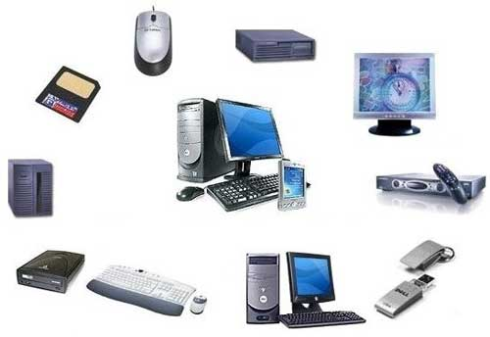
Peripheral devices
A peripheral is a device that can be attached to the computer processor.
Devices are usually classified as input, output or backing storage devices.
Peripheral devices can be external or internal.
Examples of external peripherals
include mouse, keyboard, printer,
monitor, external Zip drive or scanner.
Examples of internal peripherals
include CD-ROM drive, CD-R drive
or internal modem.
AMIT YADAV ACSE0305 COA 5

Slide 17
Input-Output Interface
Provides a method for transferring information between internal storage (such as memory and CPU registers) and external I/O devices.
They are special hardware components between CPU and peripheral to supervise and synchronize all input and output transfer.
They are called interface units because they interface between the processor bus processor bus and the peripheral device.
Resolves the differences between the computer and peripheral devices
AMIT YADAV ACSE0305 COA 5

Slide 18
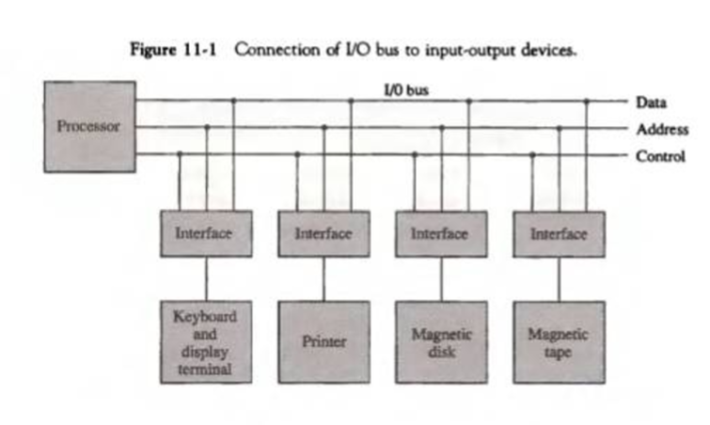
IO interface
AMIT YADAV ACSE0305 COA 5

Slide 19
IO interface
Interface :
Decodes the device address (device code)
Decodes the commands (operation)
Provides signals for the peripheral controller
Synchronizes the data flow and supervises the transfer rate between peripheral and CPU or Memory
4 types of command interface can receive : control, status, data o/p and data i/p
AMIT YADAV ACSE0305 COA 5

Slide 20
IO interface
I/O Command is an instruction that is executed in the interface and its attached peripheral units.
Control command : is issued to activate peripheral and to inform what to do
Status command : used to test various status condition in the interface and the peripherals
Data o/p command : causes the interface to respond by transferring data from the bus into one of its registers
Data i/p command : interface receives an item of data from the peripheral and places it in its buffer register.
AMIT YADAV ACSE0305 COA 5

Slide 21
IO interface
Functions of Buses
MEMORY BUS is for information transfers between CPU and the MM
I/O BUS is for information transfers between CPU and I/O devices through their I/O interface
Three ways , bus can communicate with memory and I/O :
  use two separate buses, one to communicate with memory and the other with I/O interfaces
  Use one common bus for memory and I/O but separate control lines for each
  Use one common bus for memory and I/O with common control lines for both
AMIT YADAV ACSE0305 COA 5

Slide 22
IO interface
Isolated I/O
Many computers use common bus to transfer information between memory or I/O.
Separate I/O read/write control lines in addition to memory read/write control lines
Separate (isolated) memory and I/O address spaces
Distinct input and output instructions
each associated with address of interface register
AMIT YADAV ACSE0305 COA 5

Slide 23
IO interface
Memory-mapped I/O
A single set of read/write control lines (no distinction between memory and I/O transfer)
Memory and I/O addresses share the common address space
reduces memory address range available
No specific input or output instruction
The same memory reference instructions can be used for I/O transfers
Considerable flexibility in handling I/O operations
AMIT YADAV ACSE0305 COA 5

Slide 24
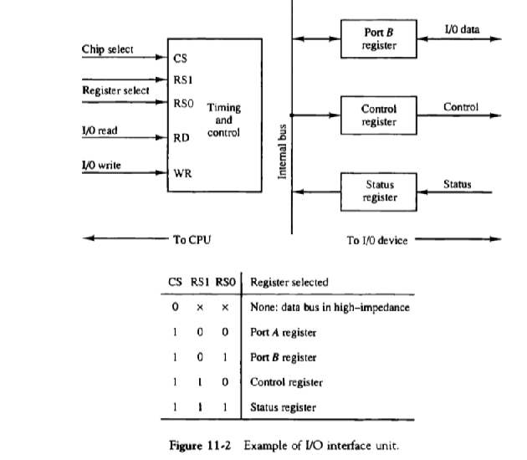
Example of IO interface and Port
AMIT YADAV ACSE0305 COA 5

Slide 25
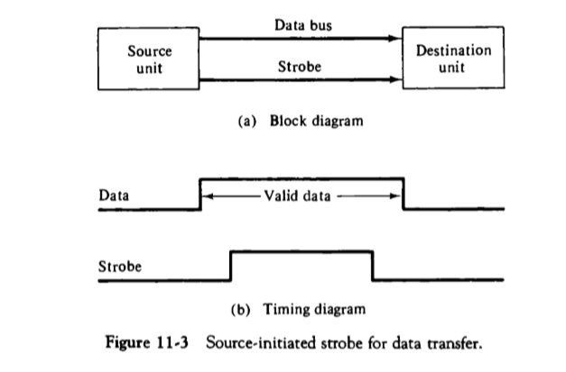
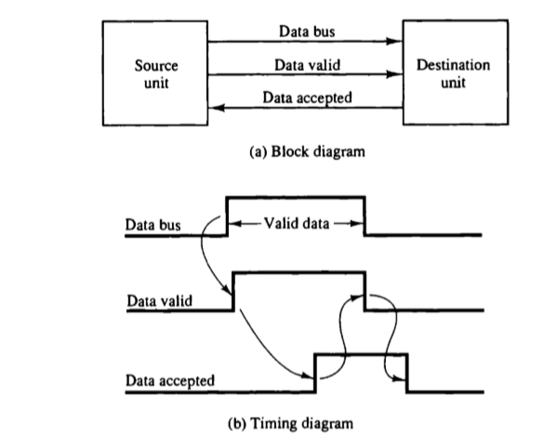
IO interface
AMIT YADAV ACSE0305 COA 5

Slide 26
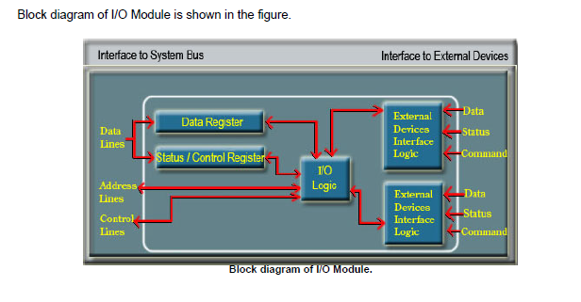
I/O Module
AMIT YADAV ACSE0305 COA 5

Slide 27
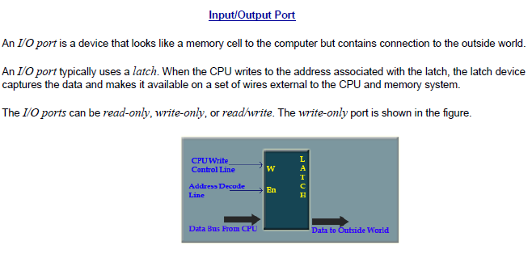
Input / Output Port
AMIT YADAV ACSE0305 COA 5

Slide 28
Daily Quiz
What is Input-Output Interface?
Write down two example of Input & output devices.
Define I/O Ports.
Input or output devices attached to the computer are also called ____________
Interrupt
Secondary storage devices
Peripheral Devices
d) Memory
5. The communication line between CPU, memory and Peripheral is called Bus
True
False
AMIT YADAV ACSE0305 COA 5

Slide 29
Daily Quiz
6. Instructions that are read from memory by an IOP are sometimes called __________, to distinguish them from instructions that are read by the CPU.
Commands
Instructions
Program
Subroutine
7. A _________ command is issued to activate the peripheral and to inform it what to do.
a) Control
b) Status
c) Data output
d) Data Input
AMIT YADAV ACSE0305 COA 5

Slide 30
Recap
A peripheral is a device that can be attached to the computer processor. Devices are usually classified as input, output or backing storage devices. Peripheral devices can be external or internal.
Examples of external peripherals include mouse, keyboard, printer, monitor, external Zip drive or scanner.
Examples of internal peripherals include CD-ROM drive, CD-R drive or internal modem.
AMIT YADAV ACSE0305 COA 5

Slide 31
Introduction to Topic 2
Name of Topic | Objective of Topic | Mapping with CO
Interrupt and its types | Students will be able to learn about an Interrupt and types of interrupt. | CO 5
AMIT YADAV ACSE0305 COA 5

Slide 32
Interrupt
Interrupt is a signal emitted by hardware or software when a process or an event needs immediate attention.
It alerts the processor to a high priority process requiring interruption of the current working process.
In I/O devices one of the bus control lines is dedicated for this purpose and is called the Interrupt Service Routine (ISR).
AMIT YADAV ACSE0305 COA 5

Slide 33
Interrupt
When a device raises an interrupt at lets say process i, the processor first completes the execution of instruction i.
Then it loads the Program Counter (PC) with the address of the first instruction of the ISR. Before loading the Program Counter with the address, the address of the interrupted instruction is moved to a temporary location.
Therefore, after handling the interrupt the processor can continue with process i+1.
While the processor is handling the interrupts, it must inform the device that its request has been recognized so that it stops sending the interrupt request signal.
Also, saving the registers so that the interrupted process can be restored in the future, increases the delay between the time an interrupt is received and the start of the execution of the ISR. This is called Interrupt Latency.
AMIT YADAV ACSE0305 COA 5

Slide 34
Interrupt
Sequence of events involved in handling an IRQ:
Devices raise an IRQ.
Processor interrupts the program currently being executed.
Device is informed that its request has been recognized and the device deactivates the request signal.
The requested action is performed.
Interrupt is enabled and the interrupted program is resumed.
AMIT YADAV ACSE0305 COA 5

Slide 35
Interrupt hardware, Types of interrupts
TYPES OF INTERRUPTS
Interrupts have highest priority than other signals, there are many type of interrupts but basic type of interrupts are –
Hardware Interrupts: If the signal for the processor is from external device or hardware is called hardware interrupts. In a hardware interrupt, all the devices are connected to the Interrupt Request Line. A single request line is used for all the n devices. To request an interrupt, a device closes its associated switch. When a device requests an interrupts, the value of INTR is the logical OR of the requests from individual devices.
Example: from keyboard we will press the key to do some action this pressing of key in keyboard will generate a signal which is given to the processor to do action, such interrupts are called hardware interrupts.
AMIT YADAV ACSE0305 COA 5

Slide 36
Types of interrupts and Exception
Hardware interrupts can be classified into two types –
Maskable Interrupt: The hardware interrupts which can be delayed when a much highest priority interrupt has occurred to the processor.
Non Maskable Interrupt: The hardware which cannot be delayed and should process by the processor immediately.
Software Interrupts: Software interrupt can also divided in to two types they are -
Normal Interrupts: the interrupts which are caused by the software instructions are called software instructions.
Exception: unplanned interrupts while executing a program is called Exception. For example: while executing a program if we got a value which should be divided by zero is called a exception.
AMIT YADAV ACSE0305 COA 5

Slide 37
Types of interrupts and Exception
It is non-maskable edge and level triggered interrupt.
TRAP has the highest priority and vector interrupt.
A trap is an exception in a user process.
Edge and level triggered means that the TRAP must go high and remain high until it is acknowledged.
There are two ways to clear TRAP interrupt.
1.By resetting microprocessor (External signal)
2.By giving a high TRAP ACKNOWLEDGE (Internal signal)
AMIT YADAV ACSE0305 COA 5

Slide 38
Types of interrupts and Exception
Handling Multiple Devices:
When more than one device raises an interrupt request signal, then additional information is needed to decide which device to be considered first. The following methods are used to decide which device to select: Polling, Vectored Interrupts, and Interrupt Nesting. These are explained as following below:
1. Polling: In polling, the first device encountered with IRQ bit set is the device that is to be serviced first. Appropriate ISR is called to service the same. It is easy to implement but a lot of time is wasted by interrogating the IRQ bit of all devices.
AMIT YADAV ACSE0305 COA 5

Slide 39
Types of interrupts and Exception
Vectored Interrupts: In vectored interrupts, a device requesting an interrupt identifies itself directly by sending a special code to the processor over the bus. This enables the processor to identify the device that generated the interrupt. The special code can be the starting address of the ISR or where the ISR is located in memory, and is called the interrupt vector.
Interrupt Nesting: In this method, I/O device is organized in a priority structure. Therefore, interrupt request from a higher priority device is recognized where as request from a lower priority device is not. To implement this each processor/device accepts interrupts only from devices/processes having priority more than it
AMIT YADAV ACSE0305 COA 5

Slide 40
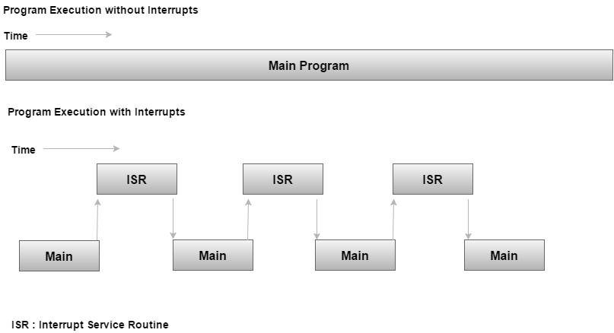
Interrupt Service routine
Interrupt Service Routine For every interrupt, there must be an interrupt service routine (ISR), or interrupt handler. When an interrupt occurs, the microcontroller runs the interrupt service routine. For every interrupt, there is a fixed location in memory that holds the address of its interrupt service routine, ISR. The table of memory locations set aside to hold the addresses of ISRs is called as the Interrupt Vector Table.
AMIT YADAV ACSE0305 COA 5

Slide 41
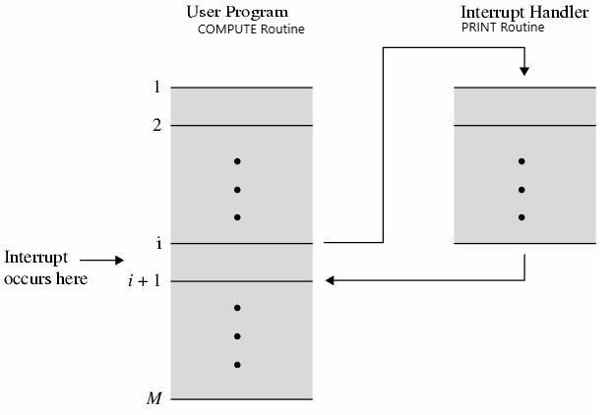
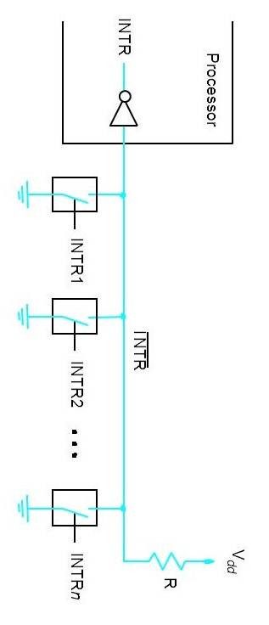
Interrupt
Interrupt service routine
Interrupt Hardware
AMIT YADAV ACSE0305 COA 5

Slide 42
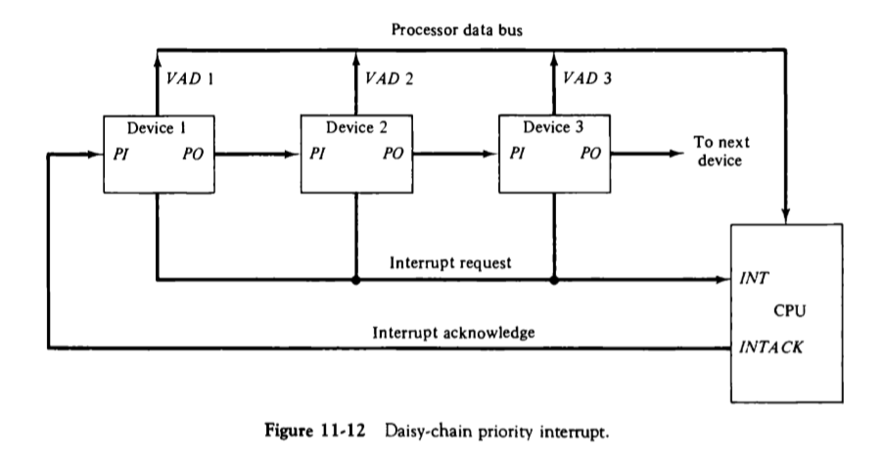
Priority Interrupt
AMIT YADAV ACSE0305 COA 5

Slide 43
Daily Quiz
1. The main job of the interrupt system is to identify the ______ of the interrupt.
a) Source
b) Signal
c) Device
d) Peripherals
2. In Daisy Chaining Priority, the device with the highest priority is placed at the ______.
a) Last Position
b) Can be placed anywhere
c) First Position
d) Depend on device
AMIT YADAV ACSE0305 COA 5

Slide 44
Daily Quiz
3. CPU has two modes privileged and non-privileged. __________ interrupt is required to change the mode from privileged to non-privileged.
a) Hardware
b) Software
4. __________ line is a control line along which the device is allowed to send the interrupt signal.
Ans: The Interrupt-request line
5. The signal sent from processor to the device after receiving an interrupt is ___________.
Ans: interrupt acknowledge
6. What do mean by Exception & TRAP ?
7. Write down various types of interrupts
AMIT YADAV ACSE0305 COA 5

Slide 45
Recap
An interrupt is a signal to the processor emitted by hardware or software indicating an event that needs immediate attention.
Types of Interrupt:
Hardware Interrupts: If the signal for the processor is from external device or hardware is called hardware interrupts.
Maskable and Non-Maskable
Software Interrupts
Vectored and Non-Vectored
Priority Interrupt
AMIT YADAV ACSE0305 COA 5

Slide 46
Introduction to Topic 3
Name of Topic | Objective of Topic | Mapping with CO
Modes of Data transfer | Students will be able to understand how data is transferred between CPU and various IO devices. | CO 5
AMIT YADAV ACSE0305 COA 5

Slide 47
Modes of Transfer
Binary information received from an external device is usually stored in memory for later processing. Information transferred from the central computer into an external device originates in the memory unit.
The CPU merely executes the 110 instructions and may accept the data temporarily, but the ultimate source or destination is the memory unit.
Data transfer between the central computer and 110 devices may be handled in a variety of modes. Some modes use the CPU as an intermediate path; others transfer the data directly to and from the memory unit.
Data transfer to and from peripherals may be handled in one of three possible modes:
1. Programmed 110
2. Interrupt-initiated 110
3. Direct memory access (DMA)
AMIT YADAV ACSE0305 COA 5

Slide 48
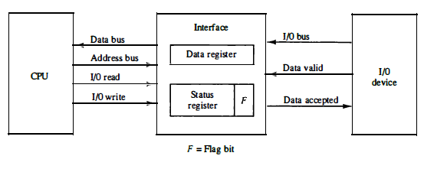
Modes of Transfer
Data Transfer from I/O device to CPU
AMIT YADAV ACSE0305 COA 5

Slide 49
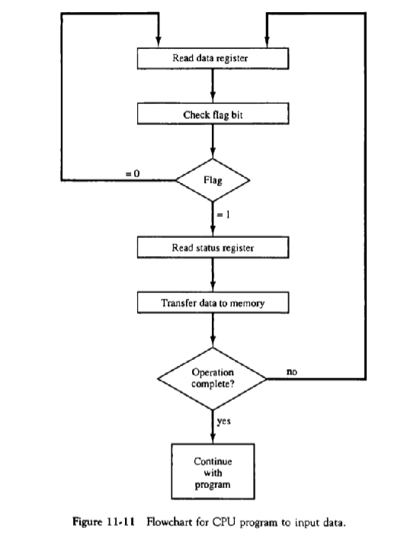
Modes of Transfer
AMIT YADAV ACSE0305 COA 5

Slide 50
Input / Output Subsystem
The I/O function can be approached in three ways:
Programmed I/O: continuous attention of the processor is required
Interrupt driven I/O: processor launches I/O and can continue until interrupted
Direct memory access: the DMA module governs the exchange of data between the I/O unit and the main memory
AMIT YADAV ACSE0305 COA 5

Slide 51
Programmed I/O
Programmed I/O:
CPU requests I/O operation
I/O module performs operations.
I/O module sets status bits
CPU checks status bits periodically
I/O module does not inform CPU directly
I/O module does not interrupt CPU
CPU may wait or come back later
Under programmed I/O data transfer is very like memory access (CPU viewpoint)
Each device is given an unique identifier
CPU commands contain identifier (address)
Memory
Databus
CPU
I/O
I/O
AMIT YADAV ACSE0305 COA 5

Slide 52
Programmed I/O
Address
Decoder
&
j
Int A?
Service routine A
&
Int C?
&
j
Service routine C
Int Z?
j
Service routine Z
AMIT YADAV ACSE0305 COA 5

Slide 53
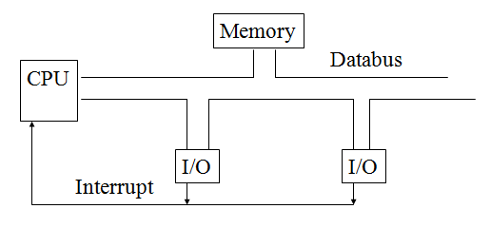
Interrupt driven I/O
Interrupt Driven I/O Basic Operation:
CPU issues read command
I/O module gets data from peripheral whilst CPU does other work
I/O module interrupts CPU
CPU requests data
I/O module transfers data
AMIT YADAV ACSE0305 COA 5

Slide 54
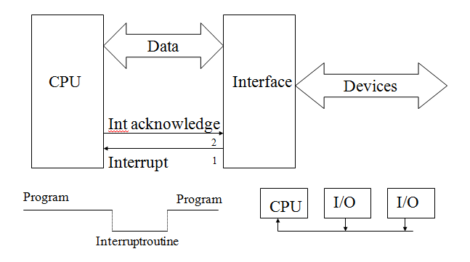
Interrupt driven I/O
AMIT YADAV ACSE0305 COA 5

Slide 55
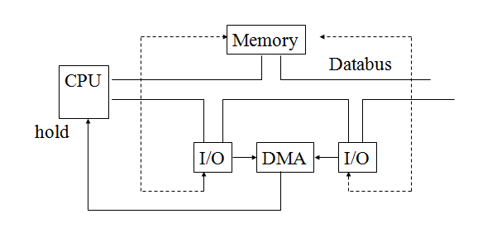
DMA
I/O module shares the bus with the processor
It can use the bus only when the CPU does not need it or it can steal cycles from the CPU by forcing it to free the bus
Procedure:
Processor sends message to DMA (R/W, where, how much)
Processor continues while I/O proceeds
At the end, I/O module sends interrupt signal to the processor
AMIT YADAV ACSE0305 COA 5

Slide 56
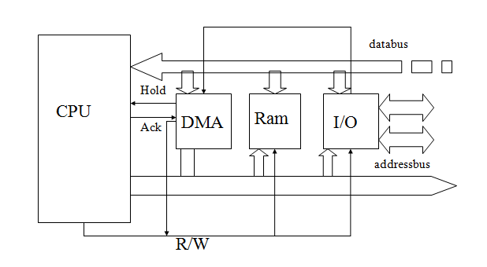
DMA
AMIT YADAV ACSE0305 COA 5

Slide 57
DMA
Direct Memory Access (DMA)
Interrupt driven and programmed I/O require active CPU intervention
Transfer rate is limited (processor to test and service the device)
CPU is tied up for managing I/O transfer.
Additional Module (hardware) on bus
DMA controller takes over from CPU for I/ODMA is the answer.
DMA module must use the bus only when the processor does not need it,
It must force the processor to suspend operation temporarily. This technique is called cycle stealing
AMIT YADAV ACSE0305 COA 5

Slide 58
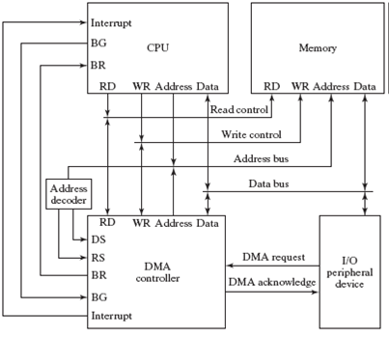
DMA
AMIT YADAV ACSE0305 COA 5

Slide 59
DMA
DMA Operation:
CPU tells DMA controller:-
–Read/Write
–Device address
–Starting address of memory block for data
–Amount of data to be transferred
CPU carries on with other work
DMA controller deals with transfer
DMA controller sends interrupt when finished
Cyclic Stealing :
In this DMA controller transfers one word at a time after which it must return the control of the buses to the CPU. The CPU merely delays its operation for one memory cycle to allow the direct memory I/O transfer to “steal” one memory cycle.
AMIT YADAV ACSE0305 COA 5

Slide 60
I/O channel and processors
A channel is an independent hardware component that co-ordinate all I/O to a set of controllers. Computer systems that use I/O channel have special hardware components that handle all I/O operations.
Channels use separate, independent and low cost processors for its functioning which are called Channel Processors.
Channel processors are simple, but contains sufficient memory to handle all I/O tasks. When I/O transfer is complete or an error is detected, the channel controller communicates with the CPU using an interrupt, and informs CPU about the error or the task completion.
AMIT YADAV ACSE0305 COA 5

Slide 61
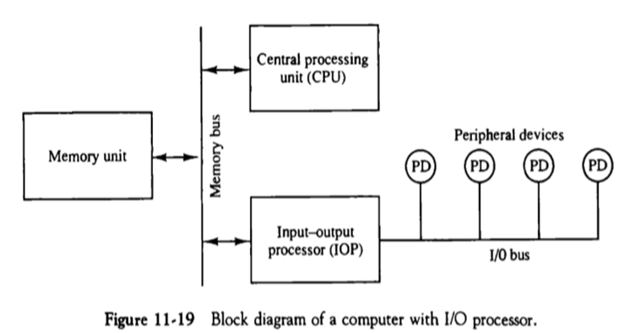
I/O channel and processors
AMIT YADAV ACSE0305 COA 5

Slide 62
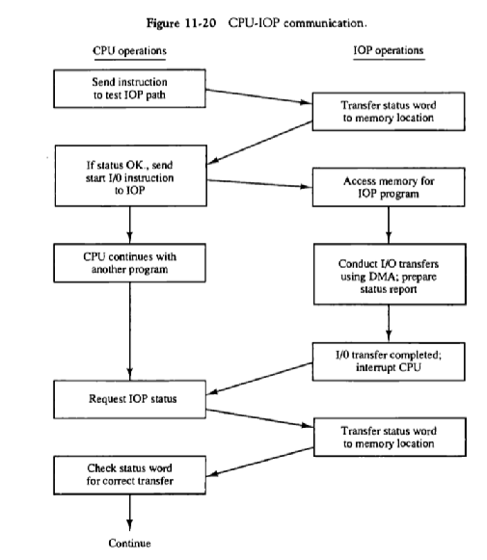
I/O channel and processors
AMIT YADAV ACSE0305 COA 5

Slide 63
Daily Quiz
What is DMA?
How many types of modes of I/O Data Transfer
a) 3
b) 2
c) 4
d) 5
3. The method which offers higher speeds of I/O transfers is ______
a) DMA
b) Interrupts
c) Memory mapping
d) None
AMIT YADAV ACSE0305 COA 5

Slide 64
Daily Quiz
4. In memory-mapped I/O ____________
a) The I/O devices have a separate address space
b) A part of the memory is specifically set aside for the I/O operation
c) The I/O devices and the memory share the same address space
d) The memory and I/O devices have an associated address space
5. The technique whereby the DMA controller steals the access cycles of the processor to operate is called __________.
Ans: cycle stealing
_________ gives the required signals and addresses during DMA transfers.
Ans: DMA controller
7. Write down full form of DMA.
AMIT YADAV ACSE0305 COA 5

Slide 65
Recap
Data transfer to and from peripheral device can be ahndlesd in three modes:
Programmed I/O
Interrupt initiated I/O
DMA
AMIT YADAV ACSE0305 COA 5

Slide 66
Introduction to Topic 4
Name of Topic | Objective of Topic | Mapping with CO
Serial Communication | Students will be able to know about serial communication and its types. | CO 5
AMIT YADAV ACSE0305 COA 5

Slide 67
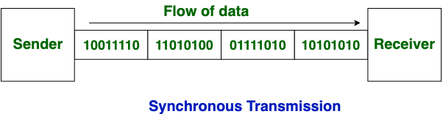
Serial Communication
Serial communication is a communication technique used in telecommunications wherein data transfer occurs by transmitting data one bit at a time in a sequential order over a computer bus or a communication channel.
It is two types-
Synchronous communication 2. Asynchronous communication
Synchronous communication
In synchronous transmission, data moves in a completely paired approach, in the form of chunks or frames.
Examples of Synchronous Transmission
Chat rooms, Video conferencing, Telephonic conversations
Face-to-face interactions
AMIT YADAV ACSE0305 COA 5

Slide 68
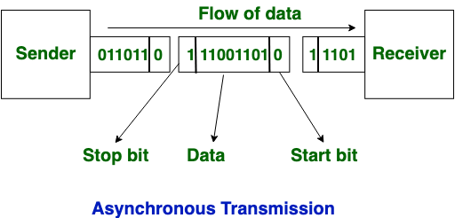
Serial Communication
Asynchronous Transmission
In asynchronous transmission, data moves in a half-paired approach, 1 byte or 1 character at a time. It sends the data in a constant current of bytes.
Examples of Asynchronous Transmission
Emails, Forums, Letters, Radios, Televisions
AMIT YADAV ACSE0305 COA 5

Slide 69
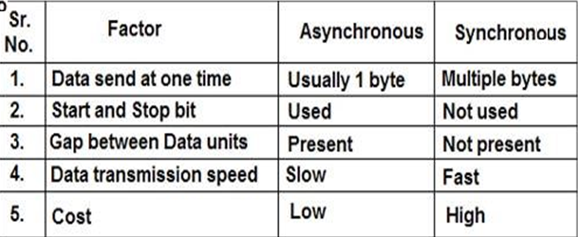
Synchronous Vs. Asynchronous
AMIT YADAV ACSE0305 COA 5

Slide 70
Daily Quiz
1. In ___________ transmission, the two units share a common clock frequency and bits are transmitted continuously at the rate dictated by the clock pulses.
a) Parallel
b) Serial
c) Synchronous
Asynchronous
2. The ______ is defined as the rate at which serial information is transmitted and is equivalent to the data transfer in bits per second.
a) Stop bit
b) Start bit
c) Baud rate
d) Read bit
AMIT YADAV ACSE0305 COA 5

Slide 71
Daily Quiz
3. In _______ data transmission, each bit of the message has its own path and the total message is transmitted at the same time.
a) Parallel
b) Serial
c) Asynchronous
d) None
4. UART stands for ________
a) Universal Asynchronous Receiver Transmitter
b) Universal Asynchronous Relay Transmission
c) Universal Accumulator Register Transfer
d) None
AMIT YADAV ACSE0305 COA 5

Slide 72
Daily Quiz
5. A hand-shake based protocol for data transfer is an example of ______ type of data transfer.
a) Parallel
b) Synchronous
c) Asynchronous
d) Serial
AMIT YADAV ACSE0305 COA 5

Slide 73
Weekly Assignment 1
Discuss the various type of Interrupts and Exception in computer organization with suitable examples.
Write short notes on-
a) I/O Interface b) I/O channels & Processor
Explain Modes of data transfer : Programmed I/O, Interrupt initiated I/O.
Explain the working of DMA controller with help of suitable diagrams.
Discuss the Synchronous and Asynchronous communication with suitable examples.
Define handshaking. Explain source - initiated and destination-initiated transfer using handshaking with help of block diagram and timing diagram.
What is programmed I/O data transfer? Draw and explain example of data transfer from an I/O device to CPU.
AMIT YADAV ACSE0305 COA 5

Slide 74
Weekly Assignment 2
Explain in detail the example of I/O interface unit with help of block diagram.
With the help of diagram explain connection of I/O bus to input- output devices. Explain the four types of command that an interface may receive.
What is priority interrupt? Explain daisy chaining priority interrupt with help of diagram.
What are peripherals? Explain different types of peripheral devices.
Why Handshaking is required in asynchronous data transfer? Explain.
Draw block diagram of 4:2 priority encoder.
Write short note on: a)Magnetic Disk Drive b) Optical drive
Explain the following with respect to DMA transfer: a) Bus request and Bus grant b)Burst Transfer c) Cycle stealing
AMIT YADAV ACSE0305 COA 5

Slide 75
Faculty Video Links, You tube Courses Details
You tube/other Video Links
https://www.youtube.com/watch?v=Vr8wJdC8jCw
https://www.youtube.com/watch?v=qgwmHnNsd6M
https://www.youtube.com/watch?v=UnLww6bH6C4
AMIT YADAV ACSE0305 COA 5

Slide 76
MCQ
1 To avoid loading during read operation, the device used is
a) latch b) flipflop c) buffer d) tristate buffer
2. The device that enables the microprocessor to read data from the external devices is, a) printer b) joystick c) display d) reader
3. The controller is connected to the ____
a) Processor BUS b) System BUS c) External BUS
4. The DMA transfers are performed by a control circuit called as
5. The DMA controller has _______ registers
a) 4 b) 2 c) 3 d) 1
6. The INTR interrupt may be
a) Maskable b) nonmaskable
7. The INTR interrupt may be masked using the flag
a) direction flag b) overflow flag c) interrupt flag d) sign flag
Solution 1 d. 2b. 3 b. 4 DMA controller . 5 c 6 a 7 c
AMIT YADAV ACSE0305 COA 5

Slide 77
MCQ
8. After the completion of the DMA transfer, the processor is notified by __________
a) Acknowledge signal
b) Interrupt signal
c) WMFC signal
d) None of the mentioned
9. The key feature of UART is _________
a) Its enhancement of connecting low speed devices
b) Its general purpose usage
c) Its simple implementation
d) Its architectural design
AMIT YADAV ACSE0305 COA 5

Slide 78
MCQ
10. When the R/W bit of the status register of the DMA controller is set to 1
a) Write operation is performed
b) Read & Write operation is performed
c) Read operation is performed
d)None of the mentioned
11. The technique whereby the DMA controller steals the access cycles of the processor to operate is called _________.
a) Memory stealing
b) Memory Con
c) Cycle stealing
d) Fast conning
AMIT YADAV ACSE0305 COA 5

Slide 79
Glossary Questions
Many computers use one common bus to transfer information between memory or I/O and the CPU. The distinction between a memory transfer and I/O transfer is made through separate read and write lines. The CPU specifies whether the address on the address lines is for a memory word or for an interface register by enabling one of two possible read or write lines. The I/O read and I/O write control lines are enabled during an I/O transfer. The memory read and memory write control lines are enabled during a memory transfer. This configuration isolates all I/O interface addresses from the addresses assigned to memory and is referred to as the isolated I/O method for assigning addresses in a common bus.
AMIT YADAV ACSE0305 COA 5

Slide 80
Glossary Questions
Explain memory read and write operations?
What is Isolated I/O method?
What are three ways that computer buses can be used to communicate with memory and I/O?
Explain memory- mapped I/O .
AMIT YADAV ACSE0305 COA 5

Slide 81




Sessional and Old Question Papers
AMIT YADAV ACSE0305 COA 5

Slide 82
Expected Questions for University Exam
Explain the working of DMA controller with help of suitable diagrams.
Write short notes on- a) I/O Ports b) I/O Interface c) I/O channels & Processor
Discuss the Synchronous and Asynchronous communication with suitable examples.
Discuss the various type of Interrupts and Exception in computer organization with suitable examples.
Explain Modes of data transfer : Programmed I/O, Interrupt initiated I/O.
Why are the read and write control lines in DMA bidirectional?
Write the difference between serial and parallel communication. Explain difference between vectored and non- vectored interrupts.
Explain CPU - IOP Communication. Draw the flowchart showing the sequence of operations to be carried out.
What is FIFO buffer? Draw and explain the circuit diagram of 4X4 FIFO buffer.
AMIT YADAV ACSE0305 COA 5

Slide 83
Expected Questions for University Exam
10. Write down the difference between Isolated I/O and Memory mapped I/O. Also discuss the advantages and disadvantages of both.
11. What do you mean by Asynchronous data transfer? Explain source and destination initiated strobe for data transfer using block diagram and timing diagram.
12. What is DMA Controller? Draw and explain the block diagram of DMA Controller.
13. What is parallel priority interrupt? Explain with help of diagram the priority logic for four interrupt sources.
14. Define handshaking. Explain source - initiated and destination-initiated transfer using handshaking with help of block diagram and timing diagram.
15. Why does the DMA priority over CPU when both request memory transfer?
16. Explain the concept of Strobe control with the help of timing diagram.
AMIT YADAV ACSE0305 COA 5

Slide 84
Recap of Unit
A peripheral is a device that can be attached to the computer processor. Devices are usually classified as input, output or backing storage devices.
Peripheral devices can be external or internal.
Examples of external peripherals include mouse, keyboard, printer, monitor, external Zip drive or scanner.
Examples of internal peripherals include CD-ROM drive, CD-R drive or internal modem.
An interrupt is a signal to the processor emitted by hardware or software indicating an event that needs immediate attention.
Types of Interrupt: Hardware Interrupts, Software Interrupts, Maskable and Non-Maskable, Vectored and Non-Vectored and Priority Interrupt
Data transfer to and from peripheral device can be ahndlesd in three modes:
Programmed I/O
Interrupt initiated I/O
DMA
AMIT YADAV ACSE0305 COA 5

